Slide 1
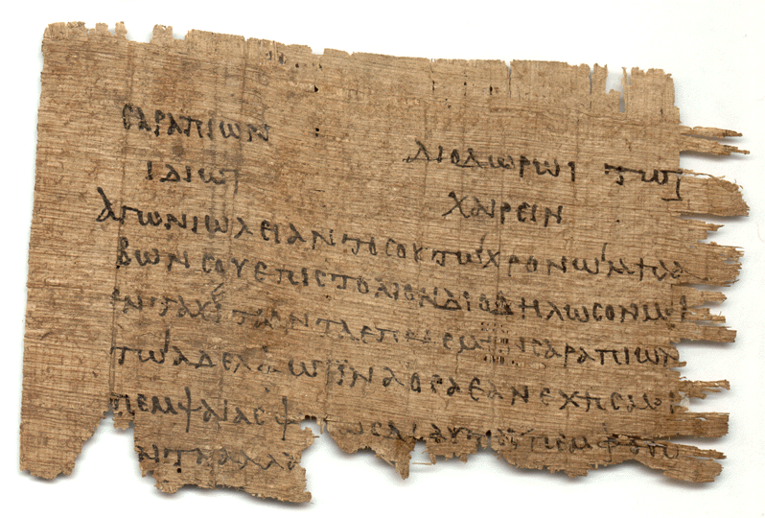
Letters of Commendation

Slide 2
Primary Lessons
Personally – It impacts on how we perceive ourselves, our humility, how we put ourselves forward in service.
Ecclesially – For the early ecclesia it demonstrates an attitude and carefulness in inter-ecclesial relationships which we would be wise to follow.

Slide 3
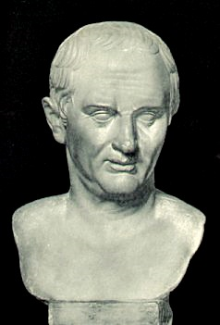
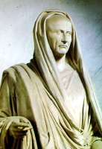
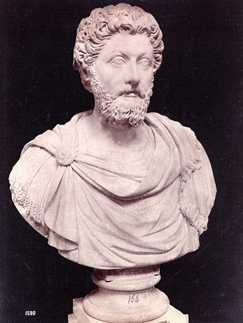
Greco-Roman Letters
Cicero (106-43 B.C.E.)
Pliny (61-120 C.E.)
Fronto (100-166 C.E.)

Slide 4
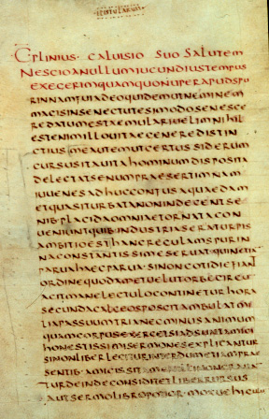
As a result of your generosity to me, Sir, Rosianus Geminus became one of my closest friends; for when I was consul he was my quaestor. I always found him devoted to my interests and ever since then he has treated me with the greatest deference… I therefore pray to you to give your personal attention to my request for his advancement; if you place any confidence in my advice you will bestow on him your favor. He will not fail to earn further promotion in whatever post you place him… I pray you, Sir, most urgently to permit me to rejoice as soon as possible in the due promotion of my quaestor---that is to say in my own advancement in his person.
Letters of Pliny, Epistolae, 10:26

Slide 5
Form and Structure of Commendation
Identify the one being commended
Cite the criteria & credentials for commendation
Make a request of the letter’s recipient

Slide 6
Luke 22:25-26
"And he said unto them, The kings of the Gentiles exercise lordship over them; and they that exercise authority upon them are called benefactors. But ye shall not be so: but he that is greatest among you, let him be as the younger; and he that is chief, as he that doth serve."

Slide 7
Greek: Commend
4921 sunistano – to set together, by implication to introduce (Rom. 16:1; 2 Cor. 3:1; 4:2; 5:12; 6:4 “approving”; 10:12,18; 12:11)
1867 epaineo / 1868 epainos – to praise (Luke 16:8 “commended”; 2 Cor. 8:18)
3860 paradidomi – to give or deliver over (Acts 14:26 “recommended”; 15:40)
3908 paratithemi – to put near, to place with someone, entrust, commit, set before (Acts 14:23; 20:32; 1 Tim. 1:18 --> 2 Tim. 2:2 “commit”)
3936 paristemi – to place near, set before, present, stand by, brought before (1 Cor. 8:8, Romans 16:2 “assist”).
1381 dokimazo / 1384 dokimos – approval after distinguishing and discerning (1 Cor. 16:3; 1 Tim. 3:10; Rom. 14:18; 2 Cor. 10:18).

Slide 8
Greek: Send
3992 pempo – to dispatch (Acts 15:22, 25; 1 Cor. 16:3; 2 Cor. 9:3; Eph. 6:22; Col. 4:8; Phil. 2:19, 23, 25, 28; 1 Thess. 3:2; Tit. 3:12)
375 anapempo – Philemon 1:12
4842 sunpempo – to send along with (2 Cor. 8:18, 22)
4311 propempo – to send forward, escort, conduct forth (Acts 15:3)
649 apostello – to send forth on service or with a commission (Acts 15:27; 19:22; 2 Cor. 12:17-18; 2 Tim. 4:12)

Slide 9
Greek: Receive
1209 dechomai – accept, receive, take (Matt. 10:39-42; Acts 21:17; 2 Cor. 7:15; Col. 4:10)
588 apodechomai – to take fully, i.e. welcome, approve, accept, receive gladly (Acts 15:4; 18:27)
4327 prosdechomai – to admit, accept, allow, by implication to await (Rom. 16:2; Phil. 2:29)
1926 epidechomai – to admit, receive (3 John 3:9-10)
2983 lambano – to take, to get hold of (2 John 1:10)
4355 proslambano (Acts 28:2; Rom. 14:1, 3; 15:7; Phile. 1:15-17)
618 apolambano – to receive in full or as a host (3 John 8)

Slide 10
Key Words
Commend / Approve
Send / Receive
Brother/Sister, fellow laborer, servant, messenger

Slide 11
NT Letters of Commendation
Paul, Barnabas, Judas and Silas (Acts 15:25-27)
Apollos (Acts 18:27)
Phoebe (Rom. 16:1-2)
Stephanus, Fortunatus and Achaicus (1 Cor. 16:15-18)
Envoys for poor fund (2 Cor. 8:16-24)
Tychicus (Eph. 6:21-22), Onesimus and Marcus (Col. 4:7-10)
Timothy (Phil. 2:19-24; 1 Cor. 4:17; 16:10-11; 1 Thess. 3:2)
Epaphroditus (Phil. 2:25-30)
Euodia and Syntyche (Phil. 4:2-3)
Leaders (1 Thess. 5:12-13)
Philemon (in full)

Slide 12
Primary Lessons
Personally – It impacts on how we perceive ourselves, our humility, how we put ourselves forward in service.
Ecclesially – For the early ecclesia it demonstrates an attitude and carefulness in inter-ecclesial relationships which we would be wise to follow.

