Slide 1
The Ecclesia
In the Acts

Slide 2
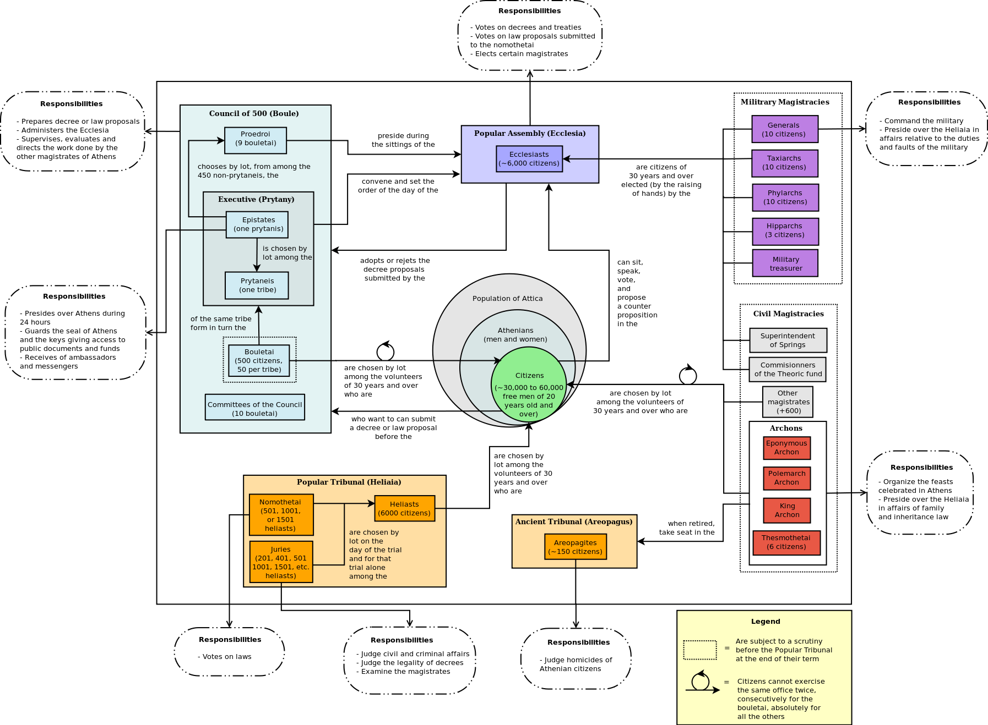

Slide 4
Jesus’ Ecclesia
“… thou art Peter, and upon this rock I will build my church; and the gates of hell shall not prevail against it.” (Matt. 16:18)
“Destroy this temple, and in three days I will raise it up. Then said the Jews, Forty and six years was this temple in building, and wilt thou rear it up in three days? But he spake of the temple of his body.” (John 2:18-22)
“We heard him say, I will destroy this temple that is made with hands, and within three days I will build another made without hands.” (Mark 14:58, only included by Mark)

Slide 6
“with one accord”
Good
1:14; 2:1, 46; 4:24; 5:12; 8:6; 15:25
Bad
7:57; 12:20; 18:12; 19:29

Slide 7
The Four Pillars of Ecclesial Life
Doctrine | Lampstand
Fellowship | Mercy seat
Breaking of bread | The table of showbread
Prayers | The altar of incense

Slide 8
The Progress Reports
Jerusalem
2:47 – 3,000 disciples
4:4 – 5,000 believers total.
5:14 – This is the second time the word church is used in Acts. Solomon’s porch has a capacity for 10,000.
6:1,7
Samaria (9:31)
Syria/Antioch (11:26; 12:24)
Asia (16:5; 19:20)
Rome (28:31)

Slide 9
Numbers 11 | Acts 6
v. 4 - A mixed multitude | v. 1 - A multitude of Grecians and Jews
v. 1, 9 - murmur | v. 1 - murmuring
v. 9 – about daily manna | v. 1 – about daily ministration
v. 11, 14 – Moses unable to bear everything | v. 2 – Apostles unable to leave word to serve tables
v. 16 – Seventy able elders sought out by Moses (Deut. 1:13, notice the qualifications are the same) | v. 3 – Seven able men sought out by the brethren
v. 16 – Seventy to stand before the Lord | v. 6 – Seven are set before the apostles
v. 17, 25 – They are given the spirit | v. 3 – The seven are full of the Holy Spirit and the apostles lay their hands on them.
v. 21 – 600,000 footmen | Was there ~6,000 disciples at this time?
v. 26 – Two stand out, Eldad and Medad | Chapters 7 and 8 – Two stand out, Stephen and Philip

Slide 10
“There must be arrangement, and it must be the work of some in particular. If those appointed to do the work are called arranging brethren, it will be a literal description, and not a name of honour. Names of honour are to be avoided in the probationary stage of the body of Christ. Seven is a convenient and scriptural number for purposes of management. Their function would be to attend to all business matters connected with the operations of the ecclesia. Their qualifications would principally require to be of a practical order.
(Robert Roberts, A Guide to the Formation and Conduct of Christadelphian Ecclesias: Clause 23)

Slide 11
“But as the business they would have to do would be business with spiritual objects, arranging brethren ought, above all things, to be men of a truly brotherly spirit, possessing a business turn, but chiefly the brotherly character. It is not sufficient that they have a business turn: they must be brethren first, arranging brethren afterwards. This is the first qualification for all offices, a point liable to be overlooked in young ecclesias. If it be asked, how is a brotherly spirit to be known, the answer is, by the test of the commandments of Christ: are they obeyed? If SO! the man has a brotherly spirit. Are they not observed in the man's conduct? Then he is not a brotherly man, and not suitable for management, however great his practical abilities may be.”
(Robert Roberts, A Guide to the Formation and Conduct of Christadelphian Ecclesias: Clause 23)

Slide 12
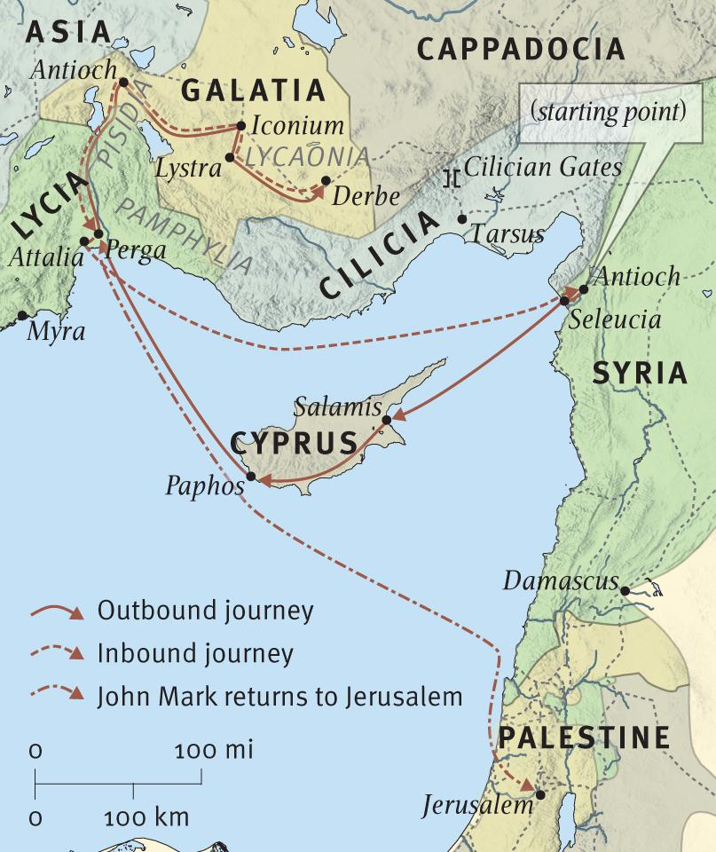

Slide 13
Commendation and Receiving
The Jerusalem Conference Letter (Acts 15:25-27)
Apollos (Acts 18:27)
Phoebe (Rom. 16:1-2)
Stephanus, Fortunatus and Acaicus (1 Cor. 16:15-18)
Envoys for the poor fund (2 Cor. 8:16-24)
Timothy (Phil. 2:19-24; 2 Cor. 16:10-11)
Epaphroditus (Phil. 2:25-30)
Leaders (1 Thess. 5:12-13)
Philemon (v. 15-17)

